Slide 1
Methods of Psychology
Psychologists attempt to explain behaviour- to understand its cause
Behaviours can be studied objectively, like any other natural phenomena

Slide 2
Hypothesis
Hypothesis is a starting point in any research
It is an idea, phrased as a general statement, that scientist wishes to test in an experiment
Hypothesis is a Greek word, it means, suggestion
Tentative statement about relation between two or more events

Slide 3
Examples of Hypothesis
Consumption of sugary drinks every day leads to obesity
Mathematics Anxiety Negatively Affects Performance”
Disruption Of Natural Sleep Cycle Impairs Worker Productivity”

Slide 4
Theory
A theory is a principle or idea that explains or solves a problem. Theories typically address a collection of issues.

Slide 5
Variables
Variables refer to characteristics or attributes that can be measured, manipulated, or controlled.
a person, place, thing, or phenomenon that you are trying to measure in some way

Slide 6
Types of Variables in Research
Independent Variable
Dependent Variable

Slide 7
Independent Variable
The independent variable is the cause.
This is the variable that is manipulated by the researcher. It is also known as the predictor variable, as it is used to predict changes in the dependent variable.
Examples of independent variables include age, gender, dosage.

Slide 8
Dependent variable
The dependent variable is the effect. Its value depends on changes in the independent variable.

Slide 9
Example: Independent and dependent variables
You design a study to test whether changes in room temperature have an effect on math test scores.
independent variable is the temperature of the room. You vary the room temperature by making it cooler for half the participants, and warmer for the other half.
dependent variable is math test scores

Slide 10
Plants grow faster in warmer temperatures.
Independent?
Dependent?

Slide 11
Methods of Psychology
Observational Method
Case study Method
Survey Method
Experimental Method

Slide 12
Observational Method
Naturalistic Observation
If the researcher has made the observations in real-life or natural settings such as schools, institutes, homes, open environments, etc., without interfering with the phenomena under observation, then it is known as naturalistic observation. In this type of observation, the researcher does not manipulate or control any situation, and he/she only records the spontaneous behavior of the subject (individual or event under investigation) in their natural environment

Slide 13
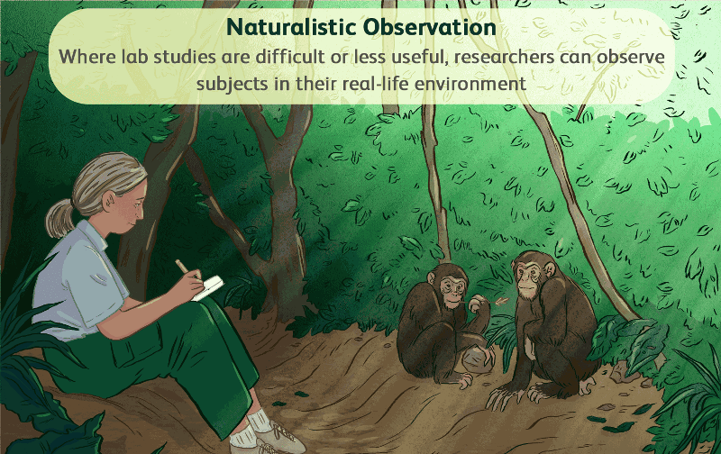

Slide 14
Controlled Observation
A research method for studying behavior in a carefully controlled and structured environment.
The researcher decides where the observation will occur, at what time, with which participants, and in what circumstances, and uses a standardized procedure.

Slide 15
For example, if the researcher wants to study the effect of induced workload on the worker’s performance, the research should be conducted in a controlled setting as the researcher can control the independent variable (workload).

Slide 16
Participant Observation
The observer or the researcher itself becomes part of the research are called participant observations. The other participants in the research may or may not be informed about the presence of the observer in the group. However, if the participants are not aware of the observer’s presence, then the results gathered will be more reliable and satisfy ecological validity.

Slide 17
Non-Participant Observation
The observer is not present in the research, but he/she uses other means to observe the spontaneous activities or behavior of the individual or group members, this may include installing the camera in the rooms that need to be observed.

Slide 18
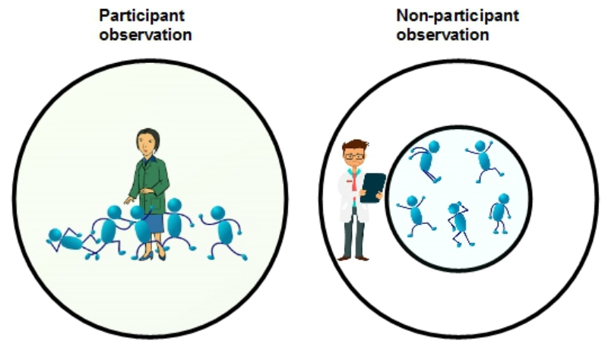

Slide 19
Case Study
A case study is an in-depth study of one person, group, or event. In a case study, nearly every aspect of the subject's life and history is analyzed to seek patterns and causes of behavior.
for example, a patient suffering from a mental disorder, a group of people belonging to the same gender, class, or ethnicity, and effect on the people of various natural or man-made disasters such as flood, tsunami, terrorism, and industrialization.

Slide 20
Survey Method
A survey method is a process, tool, or technique that you can use to gather information in research by asking questions to a predefined group of people.
Typically, it facilitates the exchange of information between the research participants and the person or organization carrying out the research.
E.g. consumer satisfaction survey

Slide 21
Experimental Method
To investigate the cause-and-effect relationship between variables
a researcher gathers plant samples and then randomly assigns half the samples to photosynthesize in sunlight and the other half to be kept in a dark box without sunlight, while controlling all the other variables (nutrients, water, soil, etc.)
By comparing their outcomes in biochemical tests, the researcher can confirm that the changes in the plants were due to the sunlight and not the other variables

